Slide 1
MongoDB with Node and Angular
Design prep and basic application components
Server Code
Client Code
Animations (pretty stuff)

Slide 2
Server – Defining the routes
Our application must be able to perform the following functions.
1. Add a product to the database.
2. List all products in the database
3. Edit items in the database
4. Delete items from the database.
This encompasses the basic CRUD functionality of an application.
For the purposes of this example product/item contains: id:number, name:string, description:string, price:number, units:number.

Slide 3
Defining the routes – Add a new product.
To create a new product we will have to pass some form data from the client to the server where it can store it in the database.
Our first route will be: app.post('/api/add' , ….... )
It will have to:
Read the body of the request (to get the data for a new item)
Check if a product of that "id" already exists
Add the request data to the database if it does not already exist.
Report back to the client of success or failure.

Slide 4
Defining the routes – List all items
To list the items currently in the database we need to performs a find query on the database to return a list of items
Our second route will be: app.get('/api/getlist , ….... )
It will have to:
Find all items in the collection
Return the list to the client

Slide 5
Defining the routes – Retrieve a single item
To be able to edit a single item we first have to get the data for that item
Our third route will be: app.post('/api/getitem , ….... )
It will have to:
Read the body of the request (to identify which item to get)
Find the item in the collection using a query that will uniquely identify that item
Return the data to the client.

Slide 6
Defining the routes – Update an item
To save any changes made to the data of an item we need to read the request data and update an existing record with new values.
Our fourth route will be: app.post('/api/update' , ….... )
It will have to:
Read the body of the request (to find out which item to update)
Set the data values of a uniquely identified item
Report back to the client of success or failure.

Slide 7
Defining the routes – Delete an item
To remove an item from the database we have to uniquely identify the item and then remove it from the database
Our fifth route will be: app.post('/api/delete' , ….... )
It will have to:
Read the body of the request ( to find out which item to delete)
Delete the data of the uniquely identified item
Report back to the client with an updated list of items.

Slide 8
Defining the routes – Other routes
To make sure that we have no duplicate id values we can create another route that can check an entered id to see if it has been used before.
Our sixth route will be: app.post('/api/checkvalidid' , ….... )
It will have to:
Read the body of the request ( to find out which id number to check)
Count the number of items with that ID.
Report back to the client if the id value had been used before and/or provide advice on what number to use next.

Slide 9
Defining the routes – Other routes
To display how many items are currently in the store we can create a route that returns the number of items.
Our seventh route will be: app.get('/api/prodcount' , ….... )
It will have to:
Count the number of items in the collection.
Report back to the client the number of items.

Slide 10
The Client Interface
The client interface is defined using Angular.
HTML/CSS styling is provided via the Bootstrap framework (added via npm install bootstrap and editing the angular.json file.
Icons are provided by Font Awsome. (CDN link added to index.html)

Slide 11
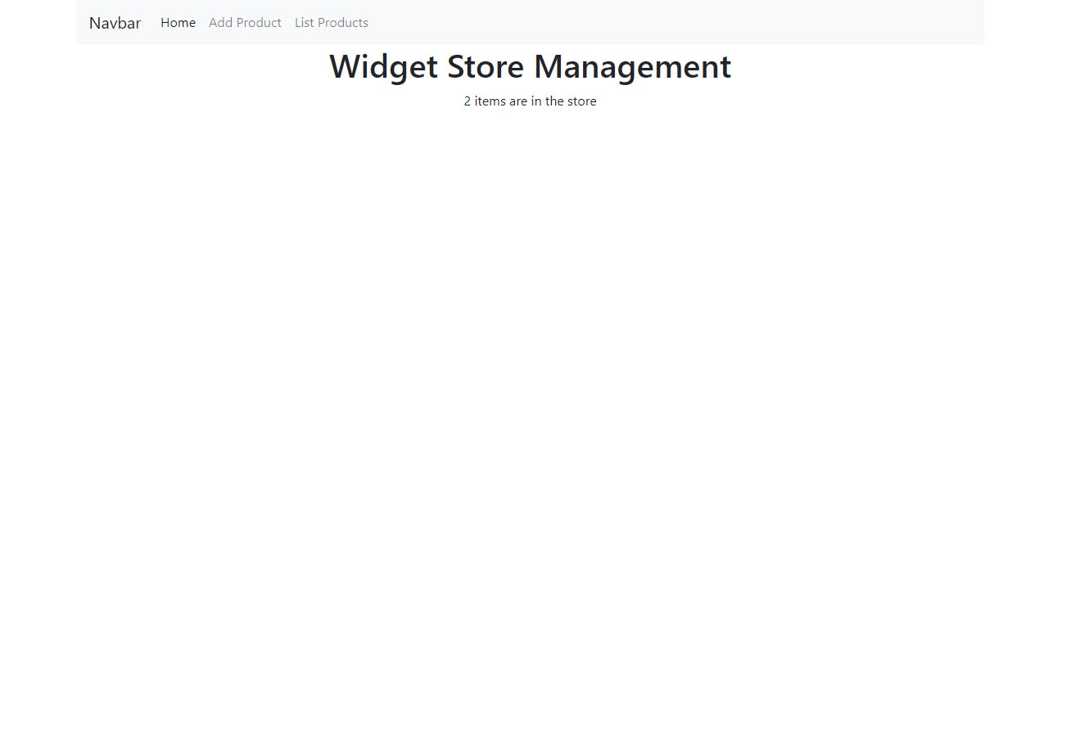
The Client Interface – Home Component
The home component displays the title of the app and the number of items currently in the store.

Slide 12
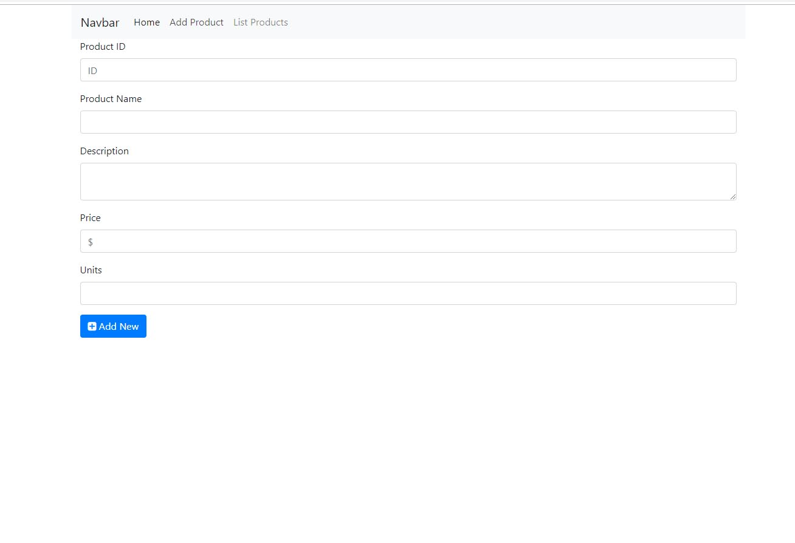
The Client Interface – Add Component
The Add Product component Provides a form for the user to enter in the required data.

Slide 13
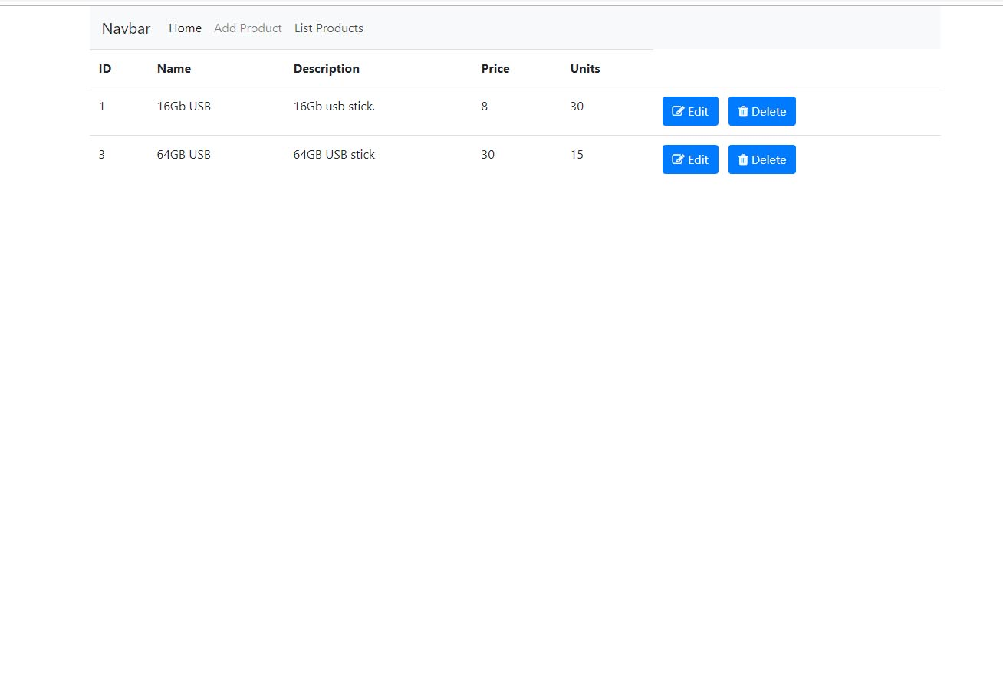
The Client Interface – List Products Component
The List Products component displays the data for each item along with a button to either edit or delete that item.

Slide 14
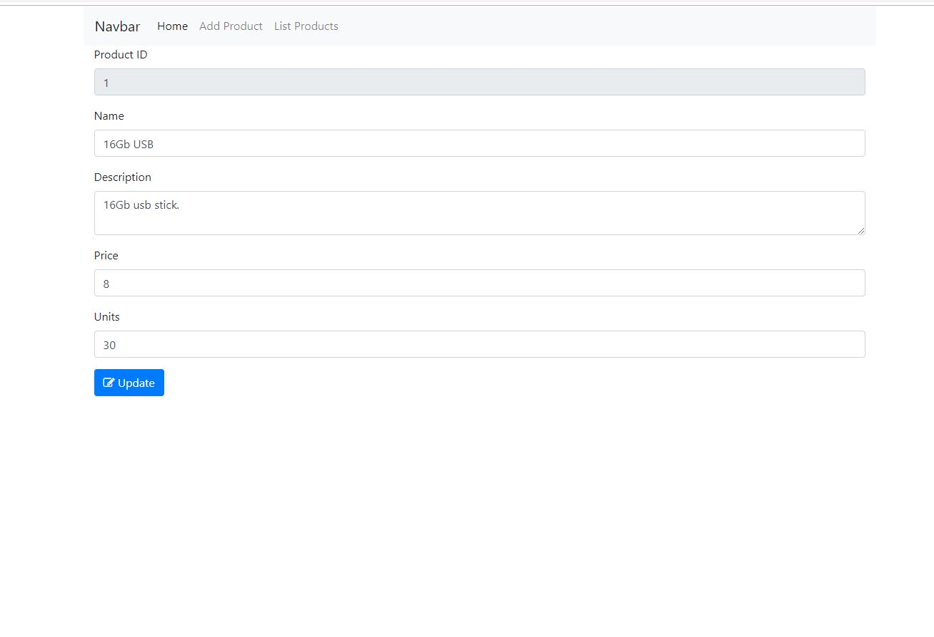
The Client Interface – Edit Product Component
The Edit Product component displays the data for each item. The product ID can not be edited.

Slide 15
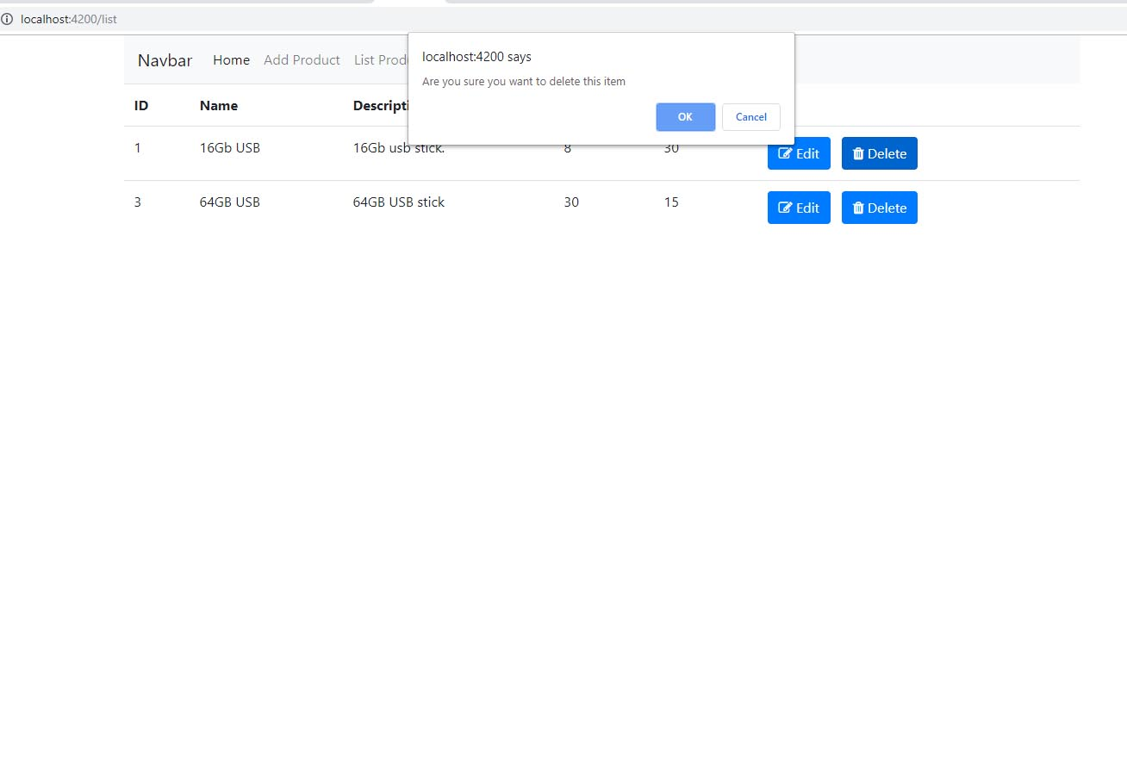
The Client Interface – Delete Product function
The delete Product function confirms with the user for removing the item from the database. A new list is returned from the function to display the items that still remain.

Slide 16
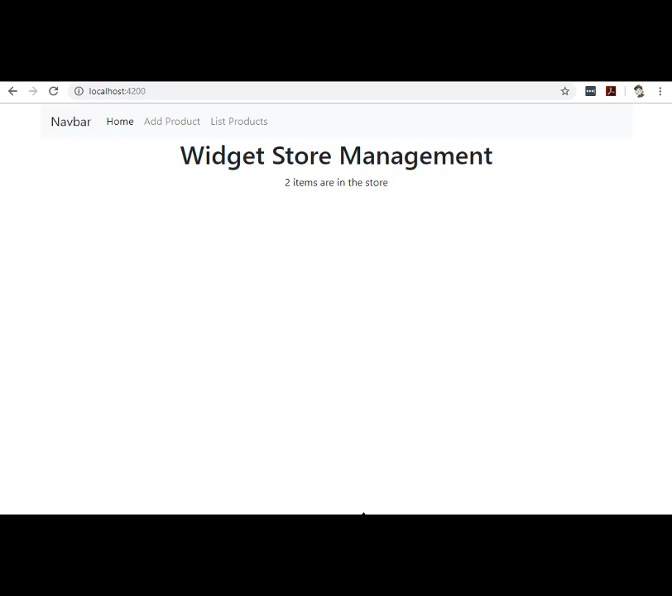
Application Running
This video quickly demonstrates the application being used.
The current count of items is displayed on the home page.
A new product is added
A product is edited
A product is deleted
A new product is created
The product count is shown again from the home page.

Slide 17
Angular – components, services, classes
Create the required components.
Home component
Add Product Component
List Product Component
Update Product Component
Create the required service to manage communication with the server
Proddata
Create the required class to define the shape of the proudct object.
Product
*** The actual names used for any of these components, services and classes is up to you. These are the names I used in the example application

Slide 18
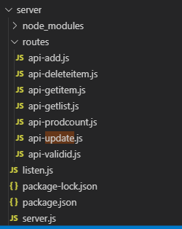
The Server Code
Now that we have an idea of what we are going to create and have the basic building block ready lets start with some code for the server.
I have structured each of the endpoints that have their own module and be located within a routes directory to keep things a bit tidy.

Slide 19
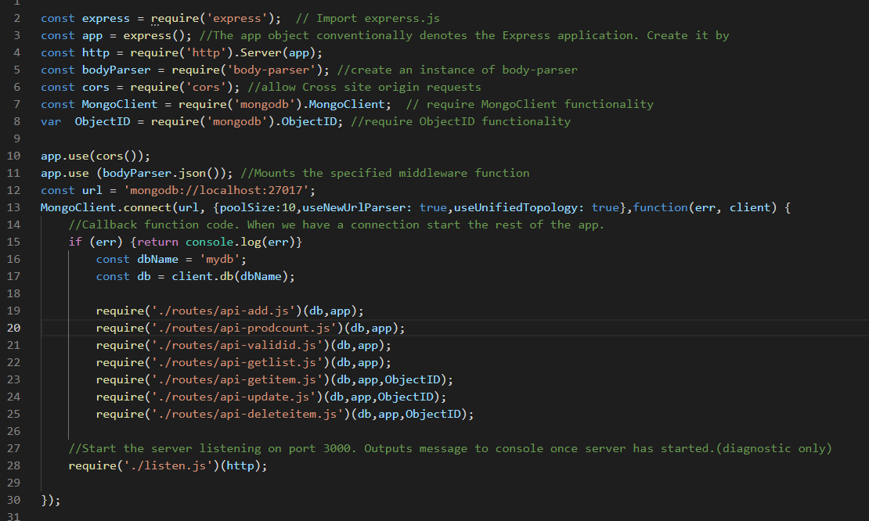
The Server Code – server.js
Appropriate modules are required to provide the functionailty needed for the app. This includes express, body-parser, cors,MongoClient and ObjectID (mongo)
A connection is made to a Mongo database running on the local machine.
If the connection is good the routes are required and the HTTP server is started.

Slide 20
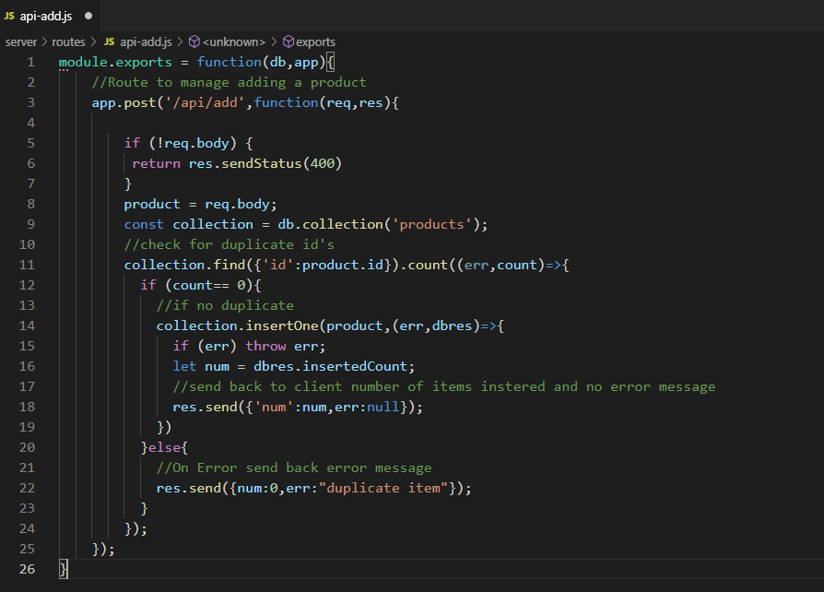
The Server Code – api-add.js
The client will be sending back an object that contains the fields entered in the form. This will come via the body of the request.
A check is done to see if an item with the same id already exists by counting up the number of items in the database with the same id.
If none exists the one document(record) is inserted into the product collection of the database.
Success or failure information is sent back to the client for it to use.

Slide 21
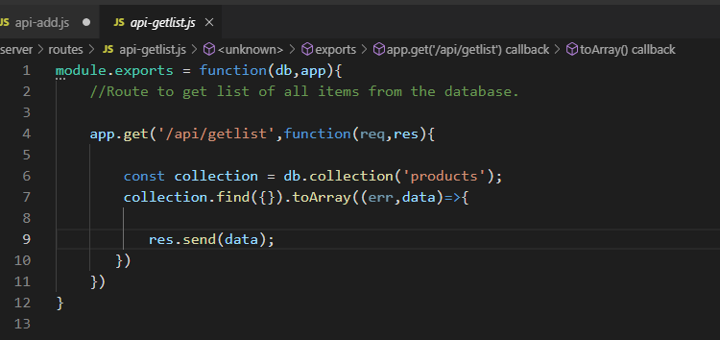
The Server Code – api-getlist.js
When the client request a list of all items in the database we can simply query for all items by passing and empty query object {} and use the toArray() method to output the data as an array rather than a database cursor.
The array can be sent back to the client for it to use.

Slide 22
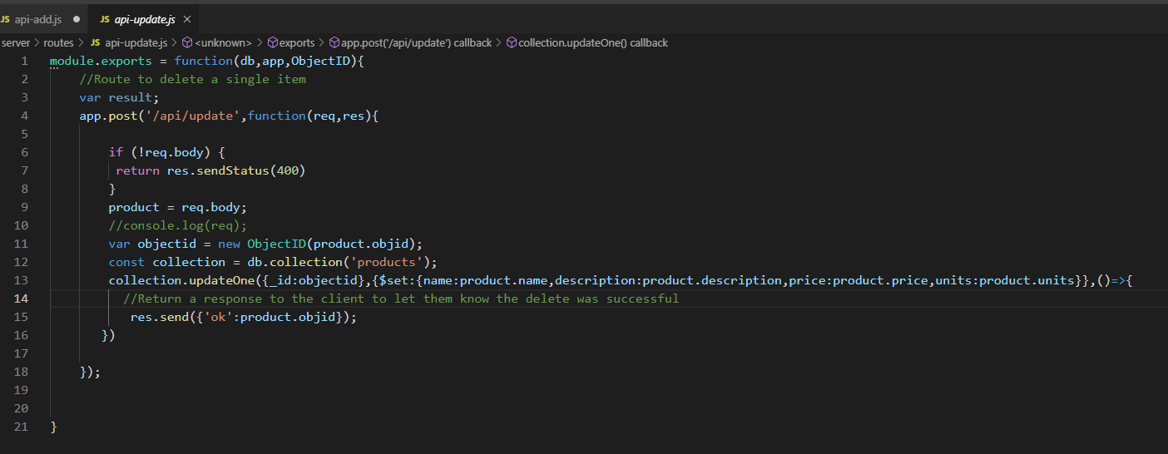
The Server Code – api-getlist.js
When the client requests for an item to be updated with some new data we have to grab the new data from the request body and do use the updateOne() mongo method to firstly filter for the item/s we want updated and set the data fields with new data. We can then respond back to the client with success.
With each document/record an "_id" field is automatically created by mongo to uniquely identify a document. I am using the mongo ObjectID method to generate a valid object from the value stored in the _id field. If you manage your own primary key you may not need to do this.

Slide 23
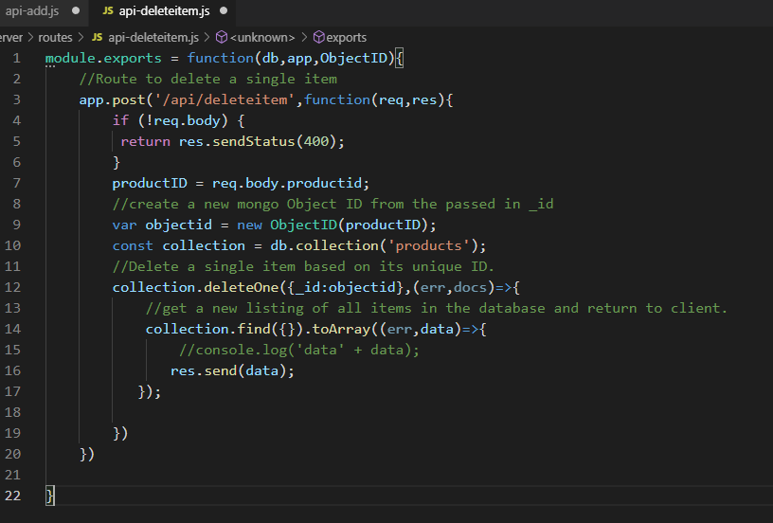
The Server Code – api-deleteitem.js
The client has sent a request to delete and item. The _id of the item to delete has been passed in the request body.
Once an item has been deleted I am then re-querying the database to get a fresh list of available products and then sending this list back to the client so it can refresh the list it uses to display the list of products.

Slide 24
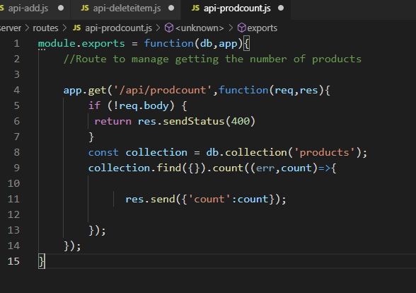
The Server Code – api-prodcount.js
The homepage displays a count of how many items are in the store.
This route send back to the client a count of all of the items in the products collection.

Slide 25
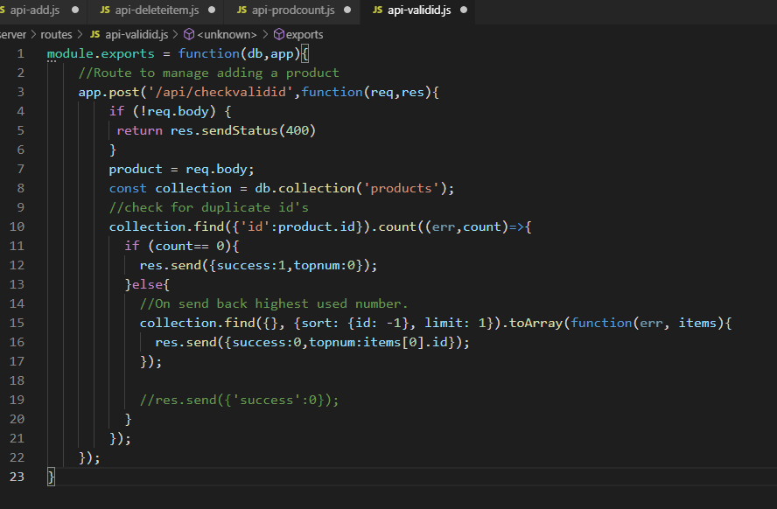
The Server Code – api-prodcount.js
Each time a user enters a product ID the app will check that that id has not been used before. If it has been used a recommendation for the next number will be provided.
Sorting a query of numeric ID's in descending order and limiting the number of results to one will provide the largest number. This is what I am sending back as a recommendation.

Slide 26
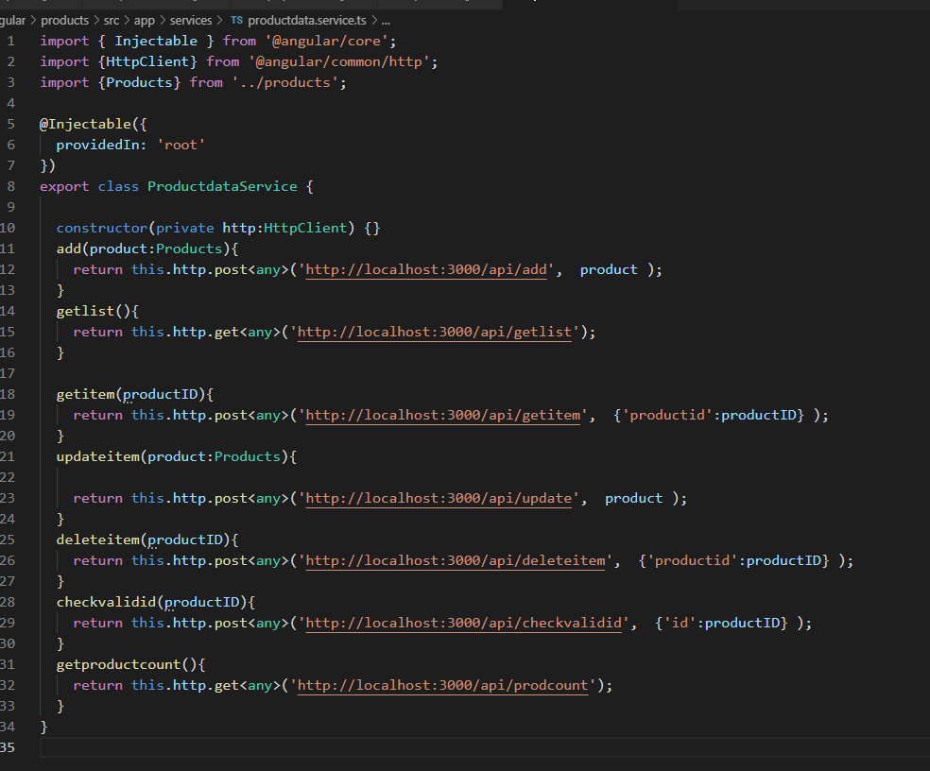
The Client Code - Service
The proddata service provides the linked between the view and the server.
This is where all of the http requests are made to the server endpoints. The http request returns an observable which we will subscribe to in our components.
The data sent back from the server will be available in the observer of the subscription.
The products class is used to define the shape of an individual product object (what are the types of the properties of the object)

Slide 27
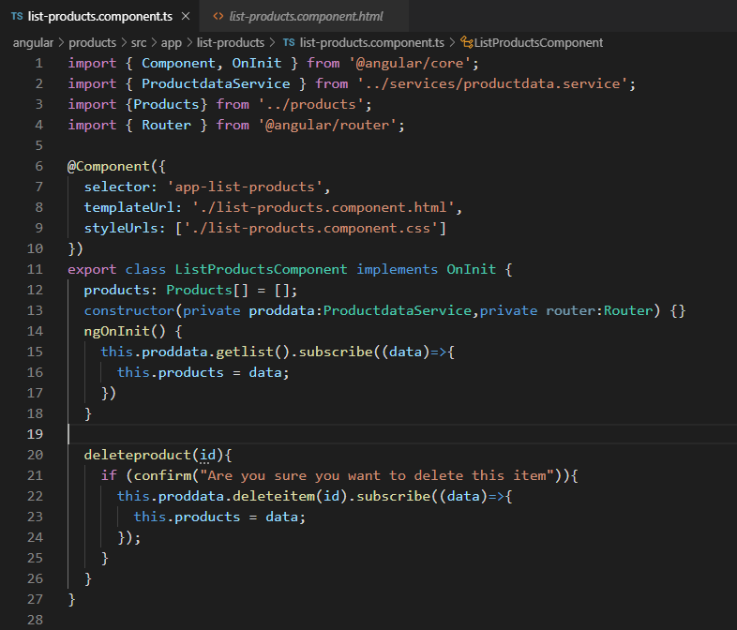
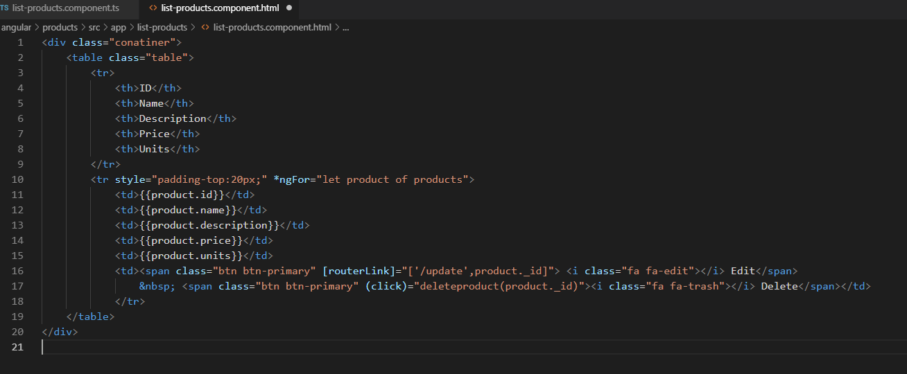
The Client Code – List Products Component
When this component is loaded it request a list of products from the server via the proddata service. This returns an array of items that is then looped over in the view using an ngFor loop to display the list.
Links for the edit and delete functions are created at this time using the product._id field to uniquely identify each item.

Slide 28
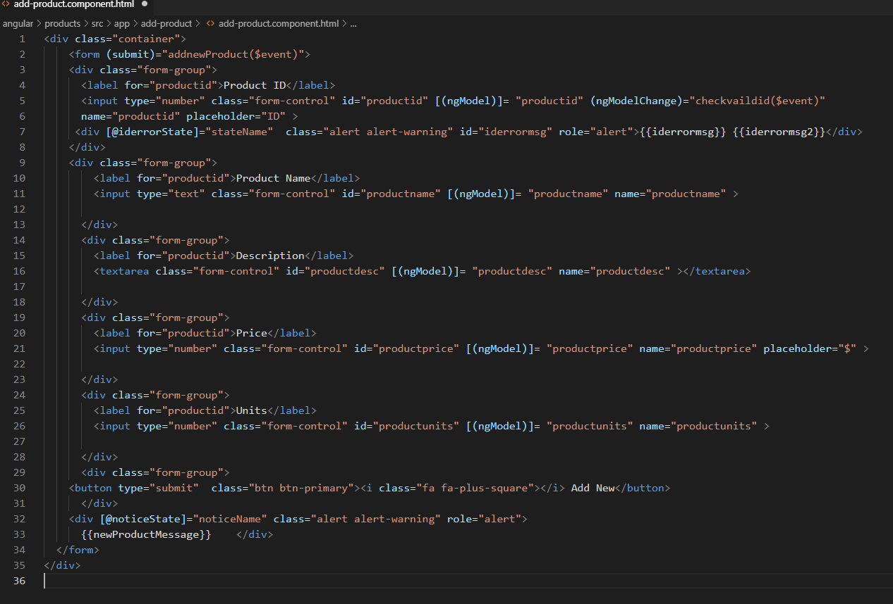
The Client Code – Add Products Component
The form used on this page makes use of the [(ngModel)] to bind to a range of product data properties.
A function is called on the submission of the form that will action the adding of a product.
Line 7 and 32 show example of using animation to fade a div block in and out as required.

Slide 29
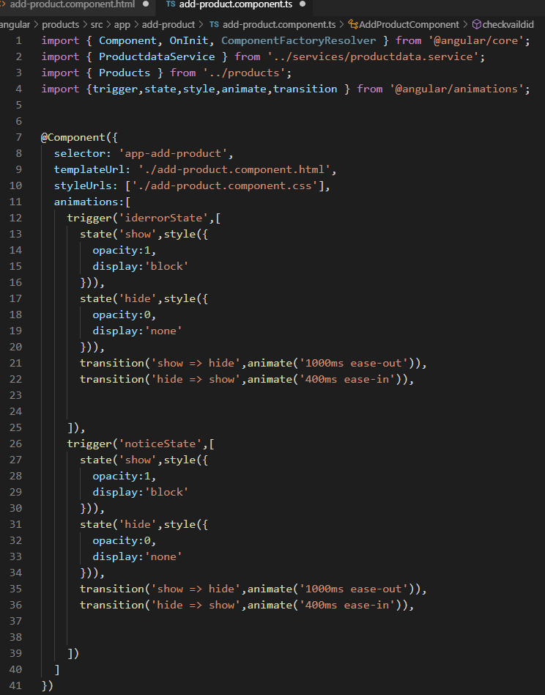
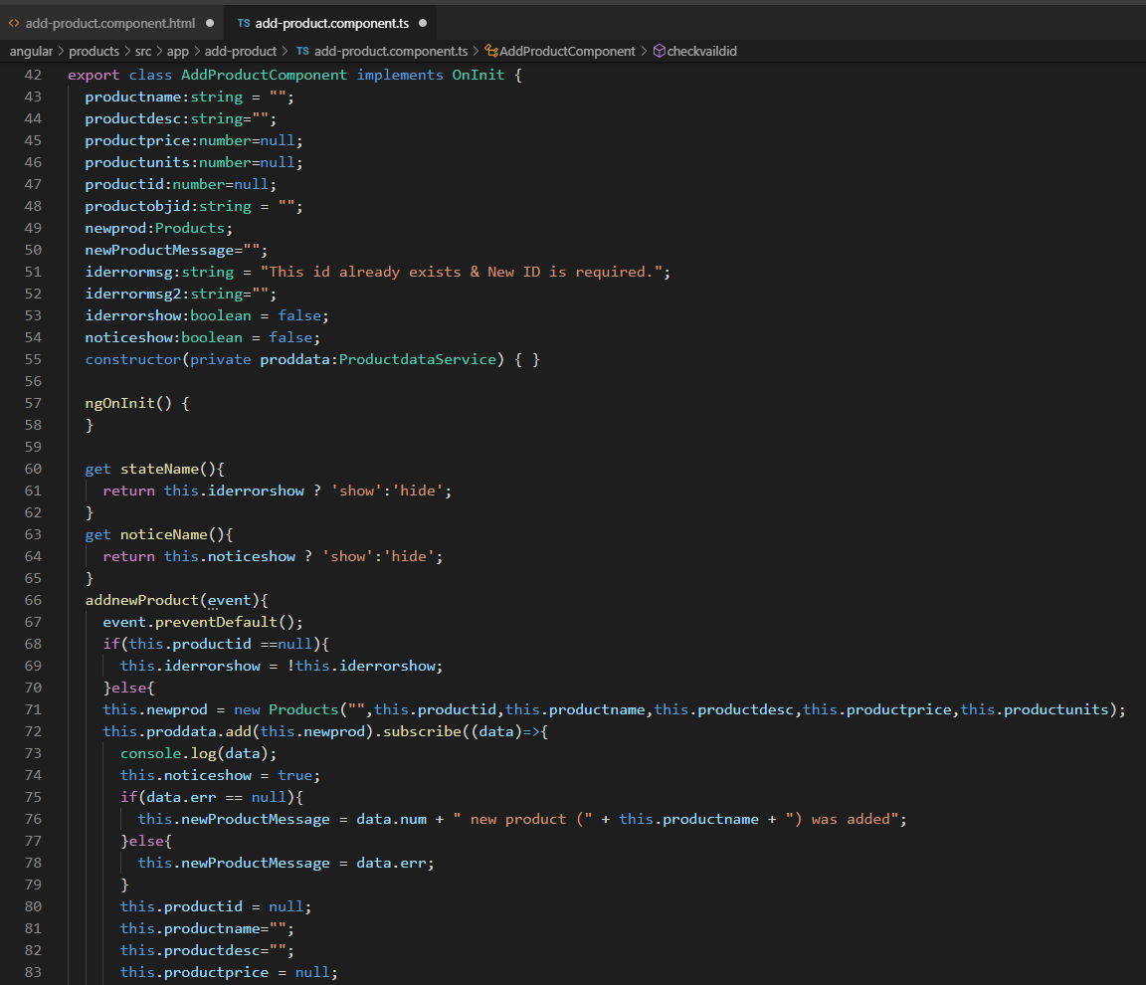
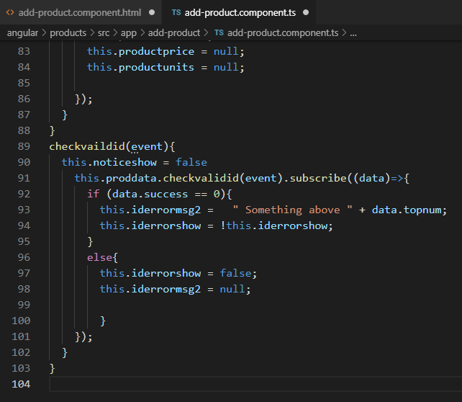
The Client Code – Add Products Component
*** Watch https://youtu.be/mVqQDEtRBwA for tips on using animation in angular
When a user changes an id value it is checked against all existing id's in the database. If a conflict is found a message box is faded in below the id field to let the use know. When an item is successfully added to the database a message fades in at the bottom of the screen and all of the fields are cleared ready for more data entry.

Slide 30
Finishing up
This should give you enough information to complete the rest of the exercise for the week 9 tutorial.

